Slide 1










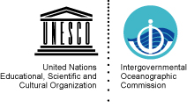
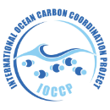



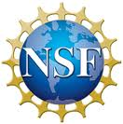




The value chain
of ocean CO₂ measurements
Dorothee Bakker (d.bakker@uea.ac.uk), Britt Alexander,
Masao Ishii, Bob Key, Peter Landschützer, Siv Lauvset, Kevin O’Brien, Are Olsen,
Benjamin Pfeil, Christian Rödenbeck, Jerry Tjiputra, Toste Tanhua, Rik Wanninkhof
and all >100 SOCAT and GLODAP contributors

Slide 2
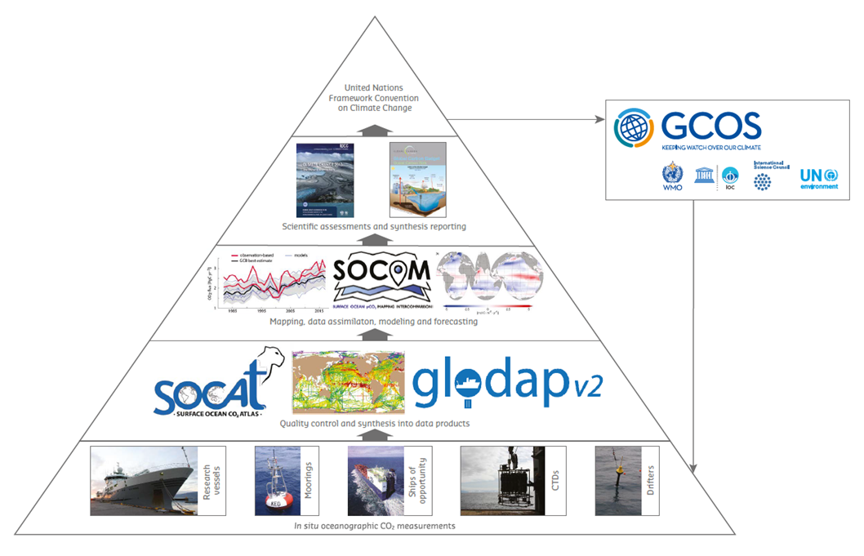

The value chain of ocean CO₂ measurements
Guidi et al. (2020) Big Data in Marine Science. EMB Future Science Brief 6, doi:10.5281/zenodo.3755793
Notes:
GCOS – Global Climate Observing System

Slide 3
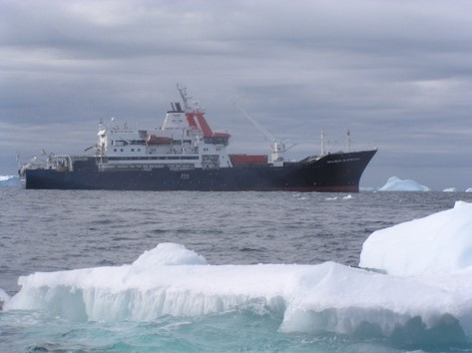
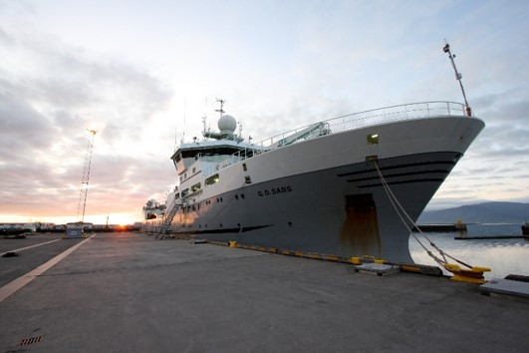
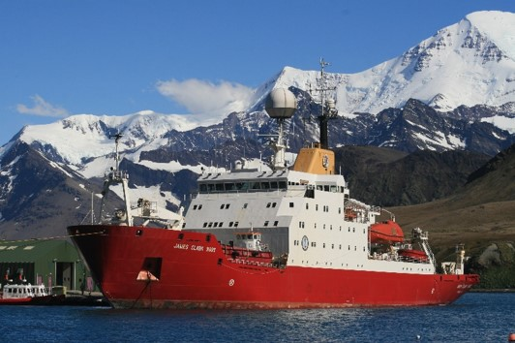
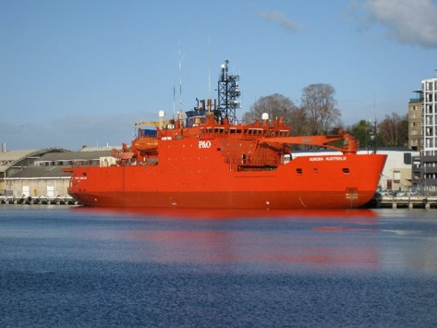
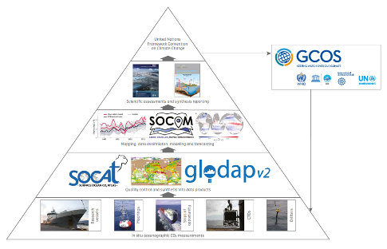
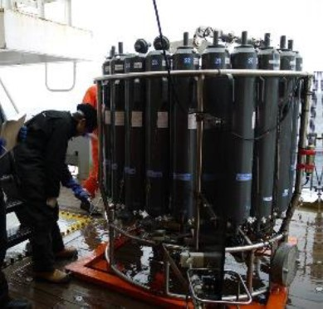
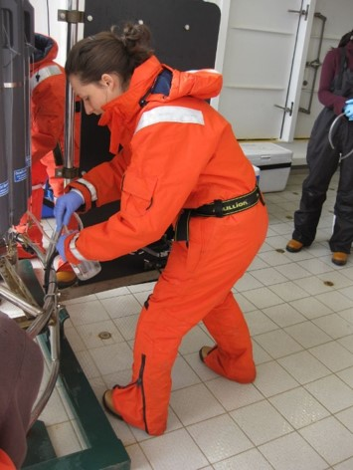
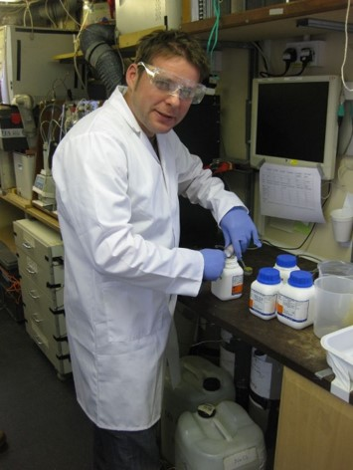
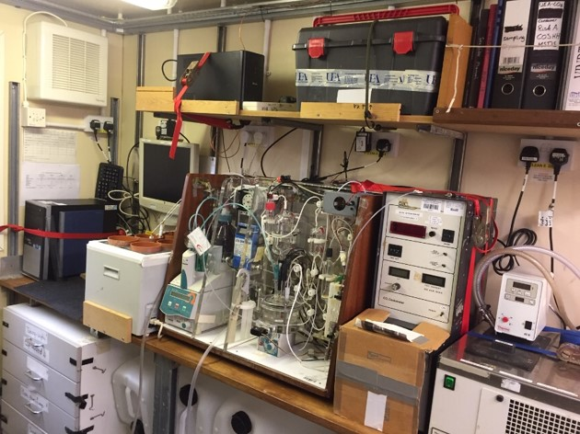
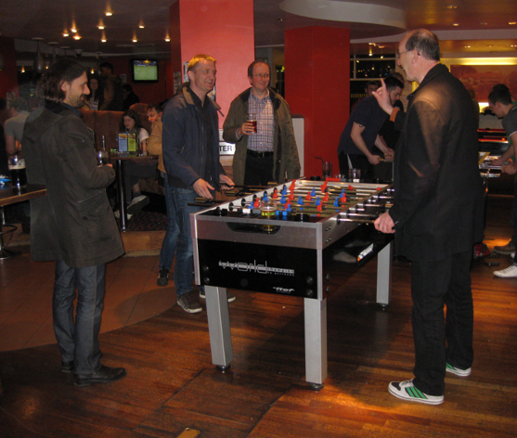
Measurements of interior ocean carbon and
other variables with secondary quality control
Notes:
Photo credits (clockwise):
1) Marion Dufresne by OISO team and Nicolas Metzl
2) GO Sars by Jerry Tjiputra
3) RRS James Clark Ross by Elizabeth Jones
4) Aurora Australis by Dorothee Bakker
5-9) Photos by Dorothee Bakker

Slide 4
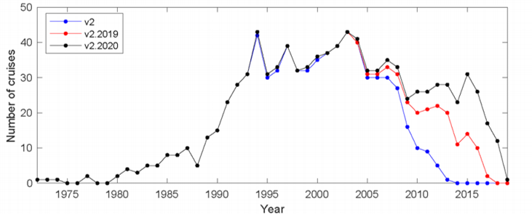
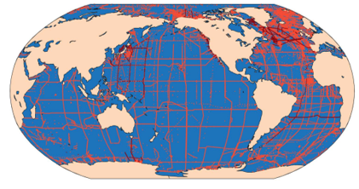
Global Data Analysis Project Version 2
(Interior ocean carbon and other observations)
www.glodap.info
GLODAPv2.2020 (1972-2019), 946 cruises
(Olsen et al., 2020)
Uniform format, bias corrected;
Core: T, S, DIC, Alk, oxygen, nutrients, freons;
Also: pH, carbon isotopes, organic carbon, nitrogen, tritium, and helium;
Bi-annual updates, decadal releases.

Slide 5


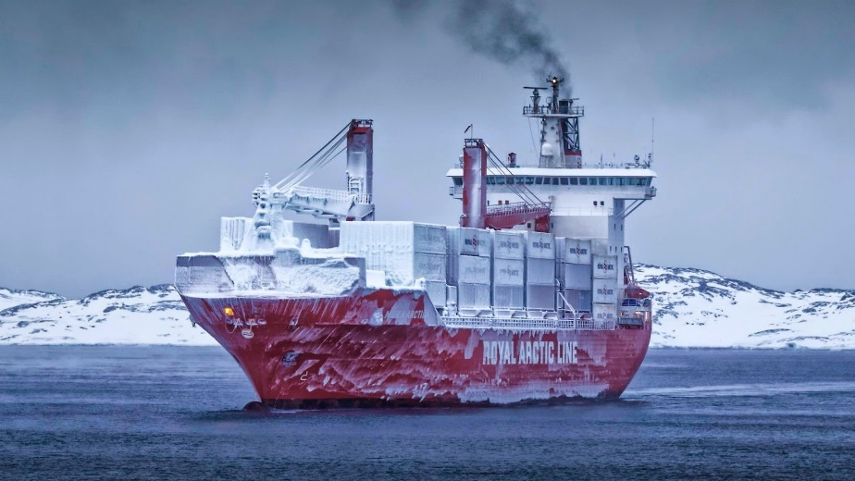
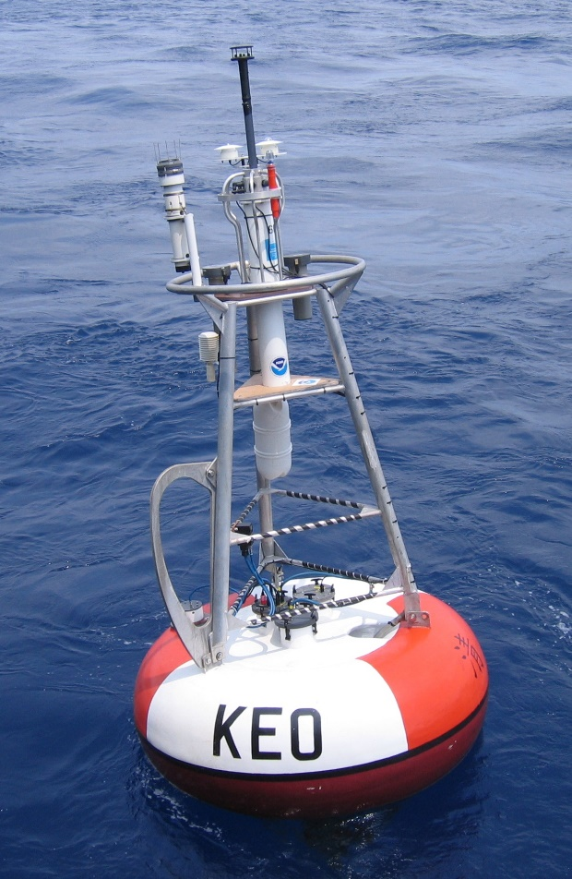
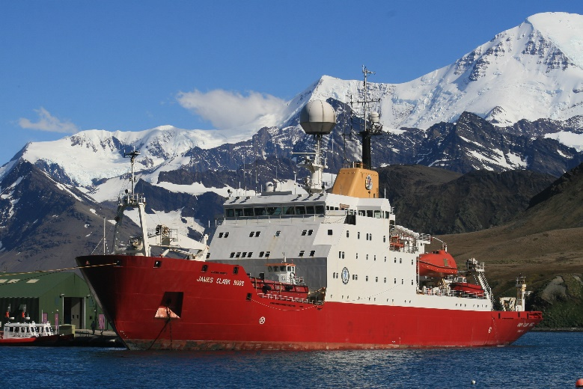
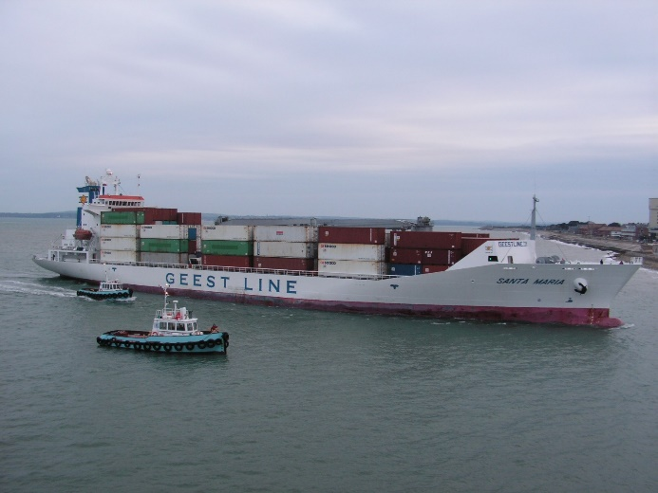
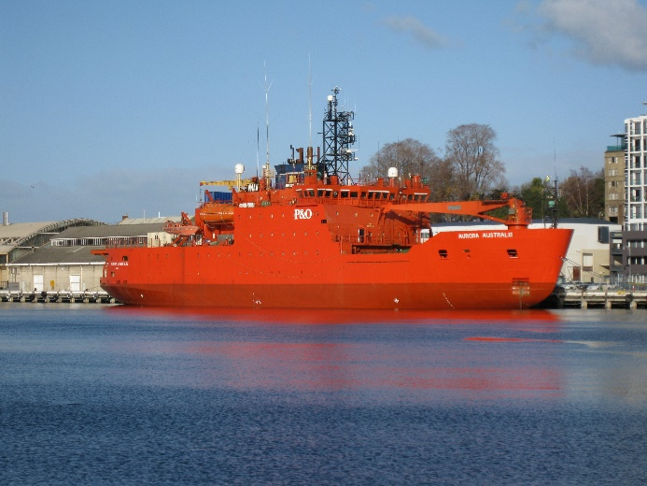
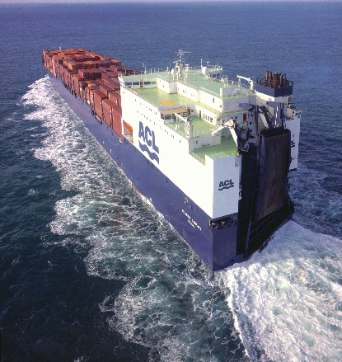
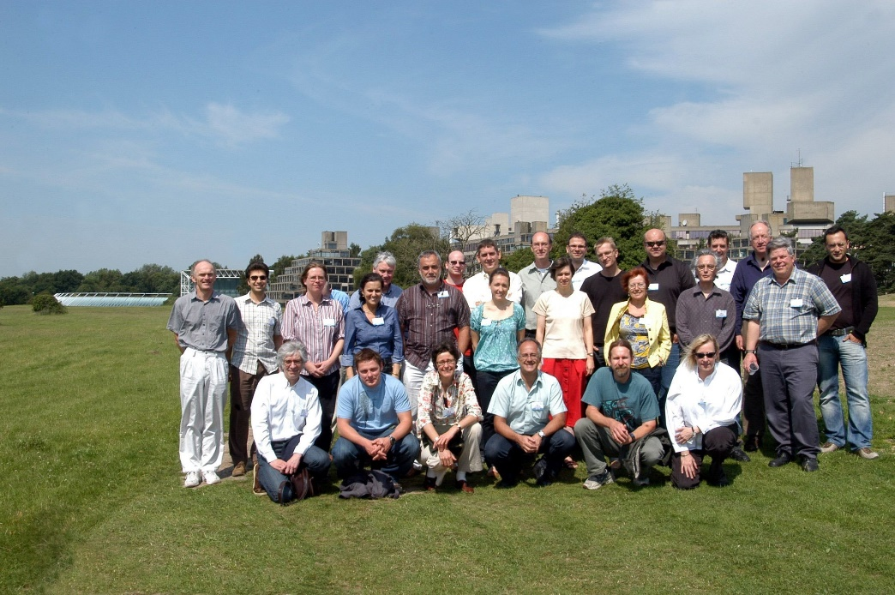
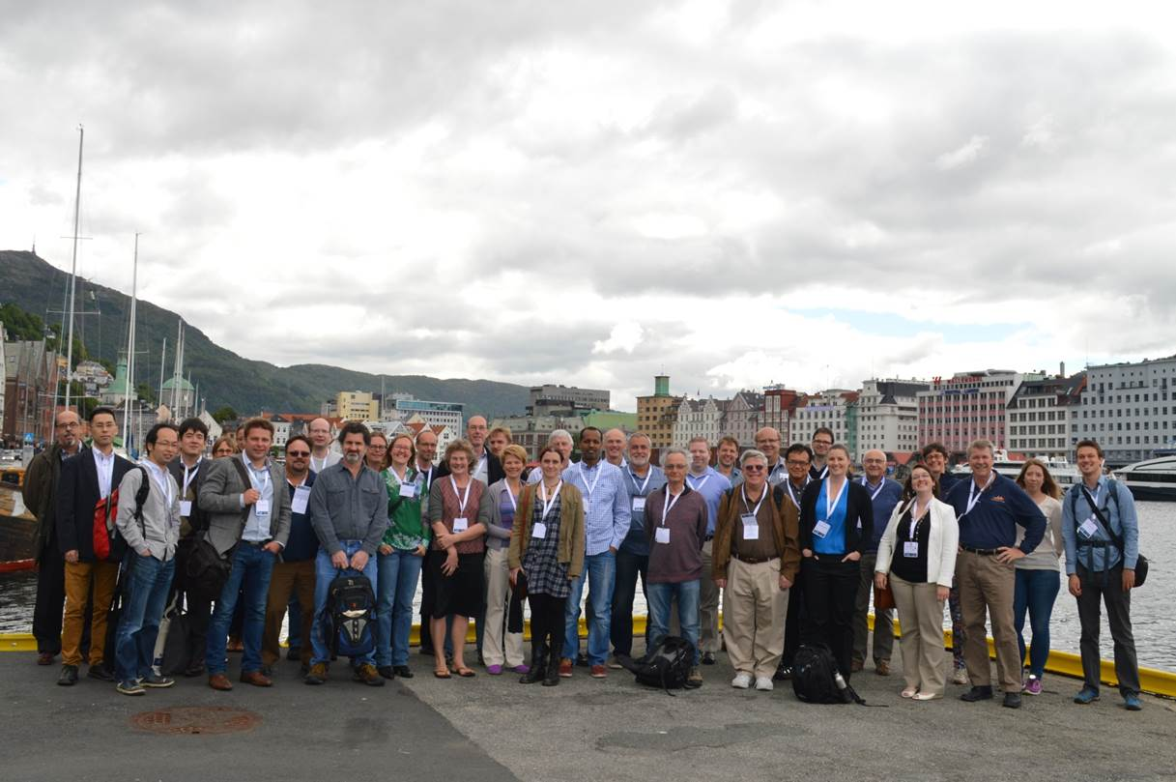
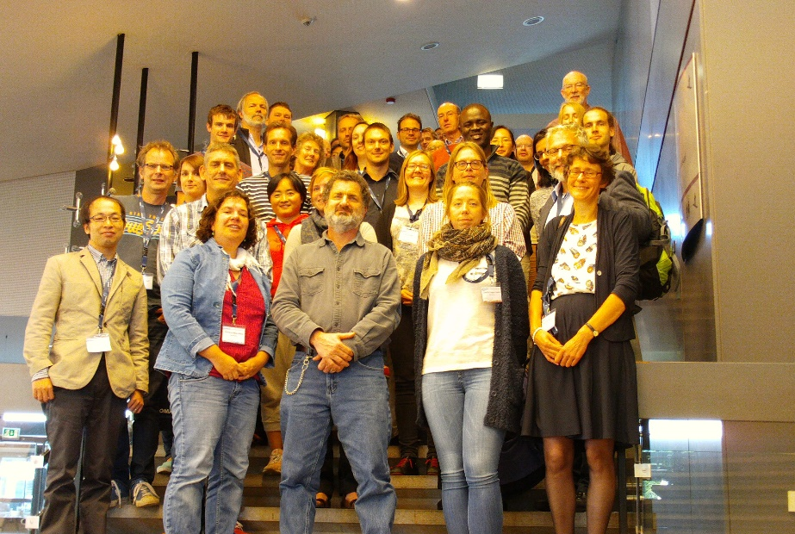
Measurements of in situ surface ocean fCO₂
on surface platforms with community-based
‘volunteer’ secondary quality control
Notes:
Photo credits (row from left to right):
1) Marion Dufresne by OISO team and Nicolas Metzl
2) GO Sars by Jerry Tjiputra
3) Nuka Arctica by Christian Haboe-Hansen
4) KEO mooring by NOAA PMEL
5) MV Santa Maria by Ute schuster
6) Aurora Australis by Dorothee Bakker
7) RRS James Clark Ross by Elizabeth Jones
8) Atlantic Companion by Tobias Steinhoff
9) SOCAT scientists in 2009 at UEA by Sheila Davies
10) SOCAT scientists at the 2014 IMBER meeting by Peter Landschuetzer
11) SOCAT scientists at the 2015 SOLAS meeting by Maria Ribas-Ribas

Slide 6
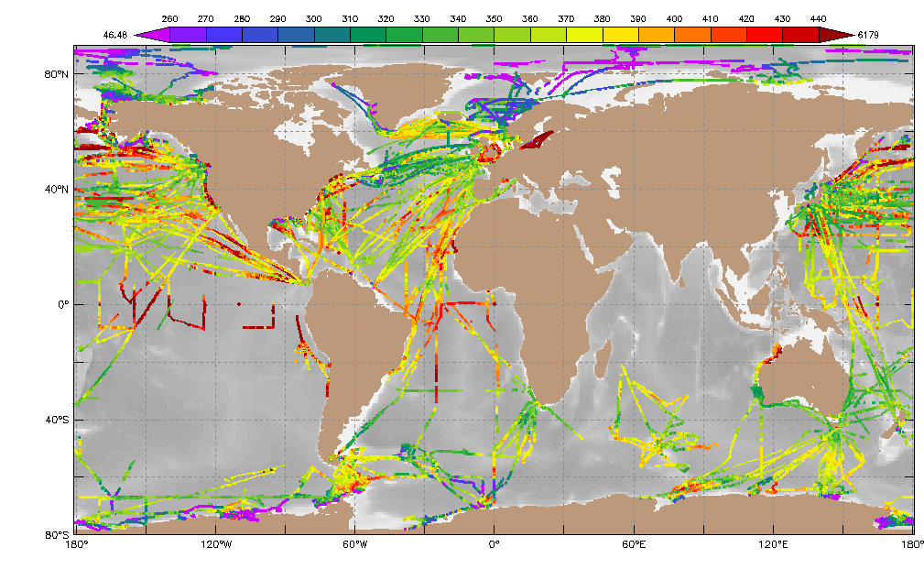
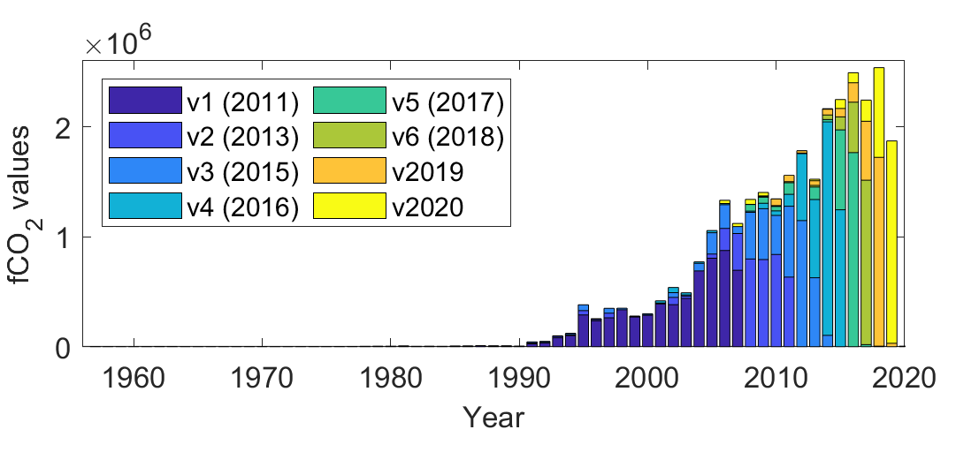
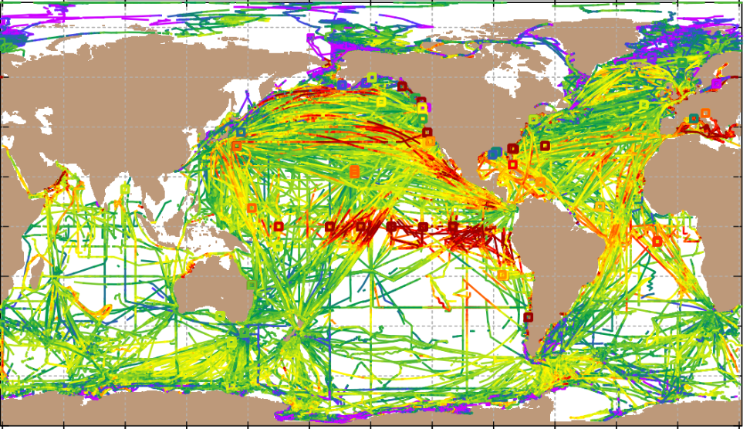
Surface Ocean CO₂ Atlas
www.socat.info
260 300 340 380 420 460
(µatm)
v2020 all
Global synthesis products of surface ocean fCO₂
fCO₂ (fugacity of CO₂) is ~ 0.997 pCO₂ (partial pressure of CO₂)
In situ fCO₂ measurements, no calculated fCO₂
Surface platforms: ships, moorings, drifters, autonomous platforms
In a uniform format with secondary quality control
No gap filling
Annual public release in mid-June
Voluntary Commitment for SDG14.3 (#OceanAction20464)
Pfeil et al., 2013; Sabine et al., 2013; Bakker et al., 2014, 2016, ESSD

Slide 7
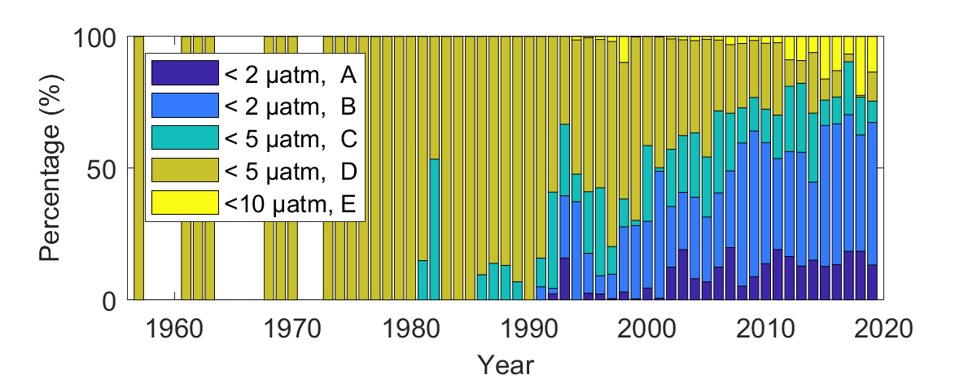
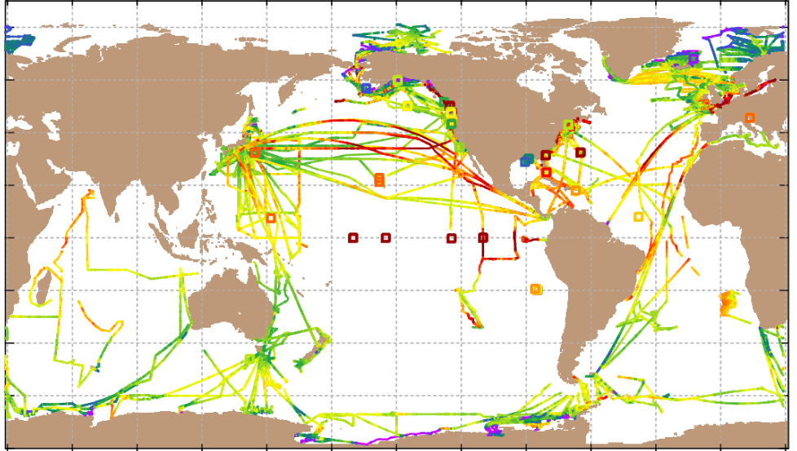
Accuracy of fCO₂
www.socat.info
260 300 340 380 420 460
(µatm)
v2020 new
Estimated accuracy reported for each fCO₂ value
SOCATv2020
28.2 million fCO₂ values from 1957-2019, accuracy < 5 μatm
In main synthesis and gridded products
Plus 2.3 million fCO₂ sensor data, accuracy 5-10 μatm
Separately available
Pfeil et al., 2013; Sabine et al., 2013; Bakker et al., 2014, 2016, ESSD

Slide 8
Tracking the increase in surface ocean fCO₂
1970-79
1980-89
1990-99
2000-09
2010-17
Number of decadal mean values per 4 µatm range in gridded SOCATv6
Atmospheric mole fraction at Mauna Loa (µmol mol⁻¹)
(By Are Olsen)

Slide 9

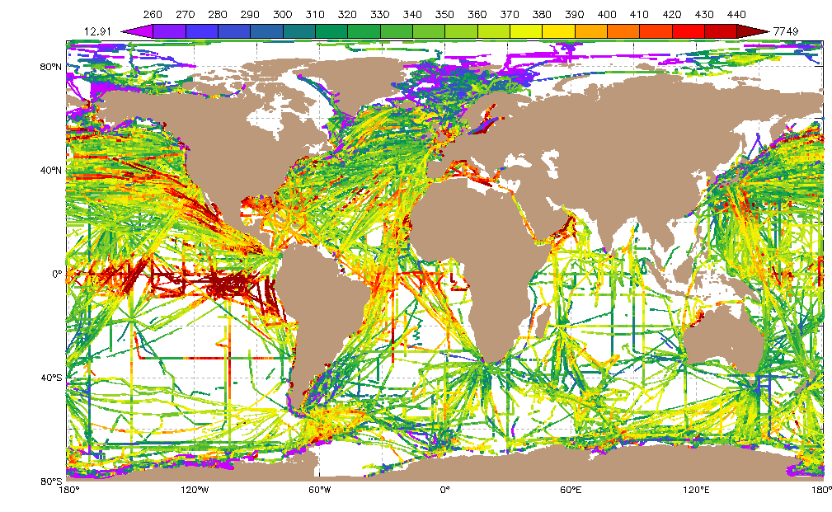
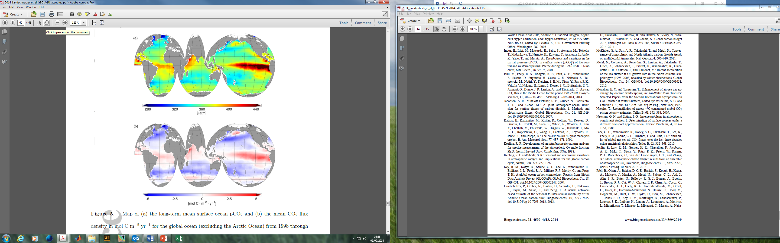
Ocean CO₂ uptake from pCO₂
www.socat.info
Mapping
Flux = k K₀ ΔpCO₂(w-a)
gas transfer parameterisation,
wind speed product
pCO₂ synthesis product
Surface ocean pCO₂
Drivers for pCO₂ mapping | Neural network (MPI-H) | Mixed layer method (MPI-J)
Atmospheric CO₂ | + | ?
Temperature (SST) | + | +
Salinity | + | +
Chlorophyll | + | -
Mixed layer depth | + | +
Contemporary air-sea CO₂ flux
Riverine CO₂ outgassing
0.45 - 0.78 Pg C yr⁻¹
Ocean uptake of
anthropogenic
CO₂ emissions
(Jacobson et al., 2007; Landschützer et al., 2014; Rödenbeck et al., 2015; Bakker et al., 2016; Resplandy et al., 2018)

Slide 10
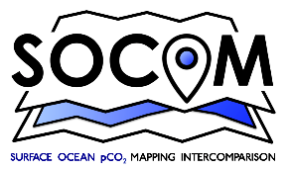
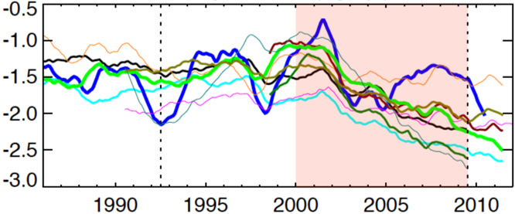
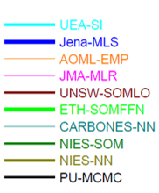
Surface Ocean pCO₂ Mapping
Intercomparison (SOCOM)
Ocean carbon sink
(Pg C/ yr)
Year-to-year and decadal variation in ocean carbon sink;
Ocean biogeochemical models underestimate this variation.
(Rödenbeck et al., 2015 BG)

Slide 11

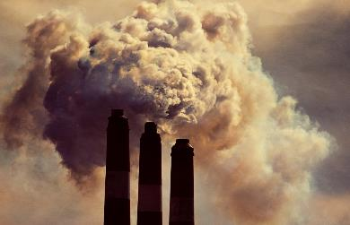
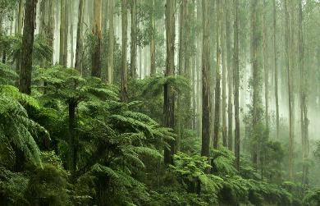
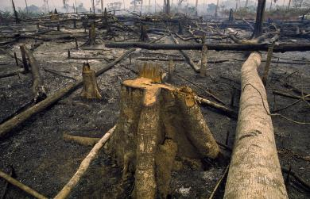
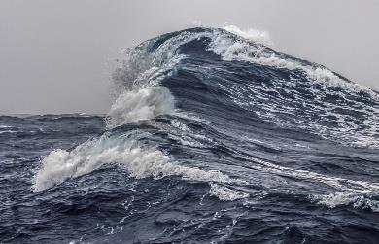
Fate of anthropogenic CO₂ emissions (2009–2018)
Sources = Sinks
4.9 Gt C/yr
44%
9.4 Gt C/yr
86%
29%
3.1 Gt C/yr
14%
1.5 Gt C/yr
23%
2.5 Gt C/yr
Budget Imbalance:
(the difference between estimated sources & sinks)
4%
0.4 Gt C/yr
Source: CDIAC; NOAA-ESRL; Houghton and Nassikas 2017; Hansis et al 2015; Friedlingstein et al 2019; Global Carbon Budget 2019

Slide 12
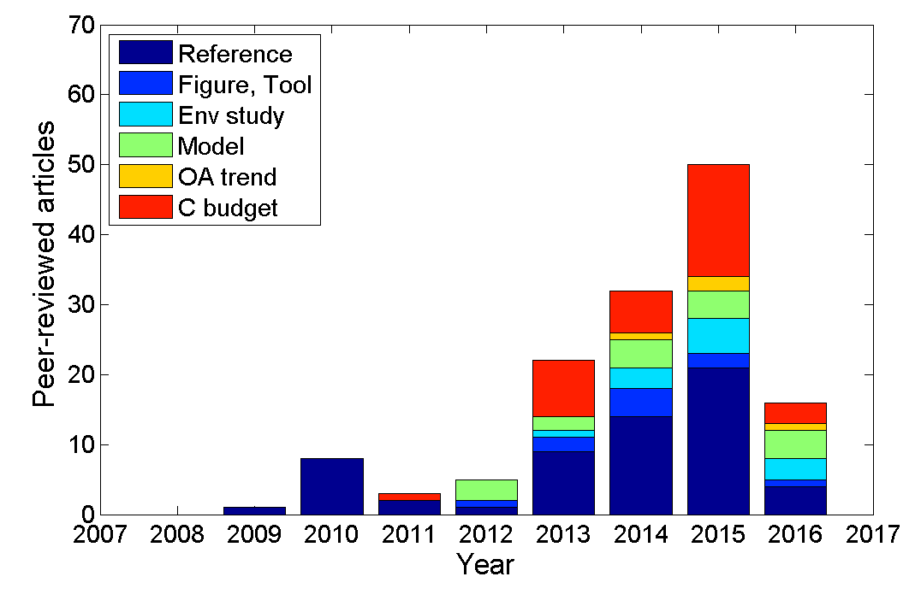
Applications of SOCAT
r
SOCAT is cited in >280 peer-reviewed articles and >80 high-impact reports.
2018
2019
Ocean carbon sink (SOCOM, BAMS, SOCCR, GCP, IPCC)
Ocean acidification studies
Evaluation of sensors (BGC Argo floats, gliders)
Model evaluation (Obs4MIP, ESMVal, CMIP)
(Bakker et al., 2016)

Slide 13


The value chain of ocean CO₂ measurements
80% of ‘sustained’ ocean observing system funded by research funding.
(Toste Tanhua, 18/03/2019)
Need for a new funding model for sustained, in situ ocean climate observations.
(Ed Hill, 16/11/2019)
Guidi et al. (2020) Big Data in Marine Science. EMB Future Science Brief 6, doi:10.5281/zenodo.3755793
Notes:
GCOS – Global Climate Observing System

